Slide 1
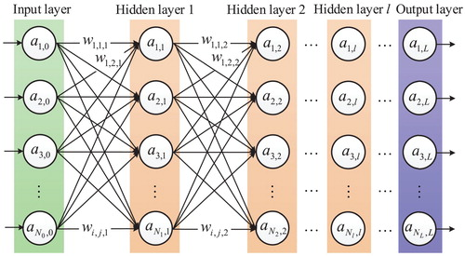
DEEP LEARNING SERIES
Face Recognition
& Deep Learning
A Beginner's Guide to Siamese Networks, One-Shot Learning & Triplet Loss
Neural Networks
Face Recognition
Exam & Interview Prep

Slide 2
OVERVIEW
What We'll Learn Today
01
Face Recognition vs Verification
02
One-Shot Learning Problem
Understanding the fundamental differences between 1:N identification and 1:1 verification systems
Why traditional deep learning fails with single examples per class
03
Siamese Networks
04
Facial Encodings
Architecture for learning similarity functions with shared weights
Converting faces to numerical embeddings in vector space
05
Triplet Loss Function
06
Exam & Interview Questions
Training strategy with anchor, positive, and negative samples
Comprehensive Q&A to test and reinforce your understanding

Slide 3
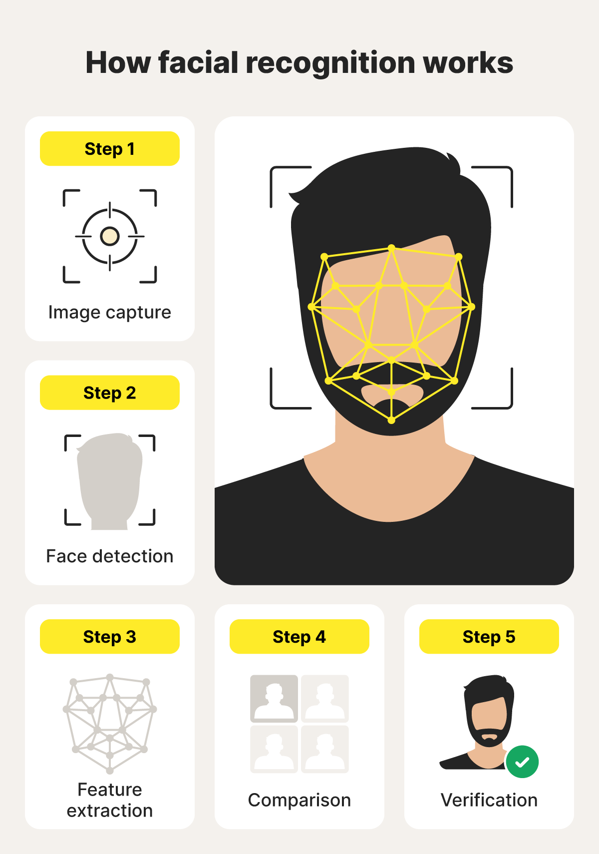
CHAPTER 01
Understanding
Face Recognition
Face Recognition vs Face Verification - Key Differences

Slide 4
FUNDAMENTAL CONCEPTS
Face Recognition vs Face Verification
Face Verification
Comparison Summary
Aspect
Verification
Recognition
Question: "Are you who you claim to be?"
1:1 Matching - Compares one face against one stored template
Matching Type
1:1
1:N
Binary Output - Returns YES/NO decision
Output
Yes/No
Identity
User Consent - Requires active participation
Consent
Required
Often No
Examples: Phone unlock, banking KYC, secure access
Privacy
Lower Risk
Higher Risk
Speed
Fast
Slower
Face Recognition
Key Insight: Same underlying technology, different applications and implications!
Question: "Who is this person?"
1:N Matching - Searches across entire database
Identity Output - Returns name/ID from database
Passive Operation - Can work without user awareness
Examples: Surveillance, watchlists, crowd monitoring

Slide 5
THE CHALLENGE
The One-Shot Learning Problem
What is One-Shot Learning?
The Solution
One-shot learning refers to the phenomenon where we have only a single image to learn or recognize a person. This is common in real-world scenarios:
Instead of classification, we need to learn a similarity function:
Employee database with one photo per person
Compare two images directly
ID verification systems (passport photos)
Output degree of difference
Use threshold (τ) for decision
Class attendance with single enrollment photo
No retraining needed for new people!
Why Traditional Approaches Fail
Decision Logic
Problem 1: Softmax Instability
If distance < τ:
With many people, softmax outputs become unstable. Adding new people requires retraining the entire network!
Same person ✓
Problem 2: Insufficient Data
If distance ≥ τ:
Deep learning typically needs hundreds of examples per class. One image is not enough to learn robust features.
Different person ✗
Problem 3: Scalability Issues
τ (tau) = threshold hyperparameter
As database grows, classification becomes harder. Output layer size changes with each new person.

Slide 6
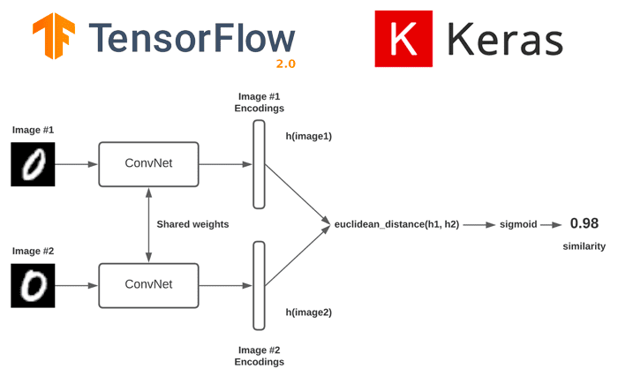
CHAPTER 02
Siamese
Networks
Architecture for Learning Similarity

Slide 7
ARCHITECTURE
What is a Siamese Network?
Core Concept
Siamese Network Architecture
A Siamese Network consists of two identical neural networks that share the same weights and architecture. They process two different inputs simultaneously and learn to compare them.
Twin Networks
Weight Sharing
Two identical CNNs with shared weights
Same parameters for both branches
Parallel Processing
Distance Metric
Both inputs processed simultaneously
Compare output embeddings
How It Works
1
Input Two Images
Applications
Feed anchor and comparison images
• Face verification/recognition
2
Generate Embeddings
• Signature verification
Each CNN produces a feature vector
• Object tracking
3
Calculate Distance
• Text similarity
Compute similarity using distance metric
4
Make Decision
Key Advantage: Learns similarity, not classification!
Compare distance to threshold τ

Slide 8
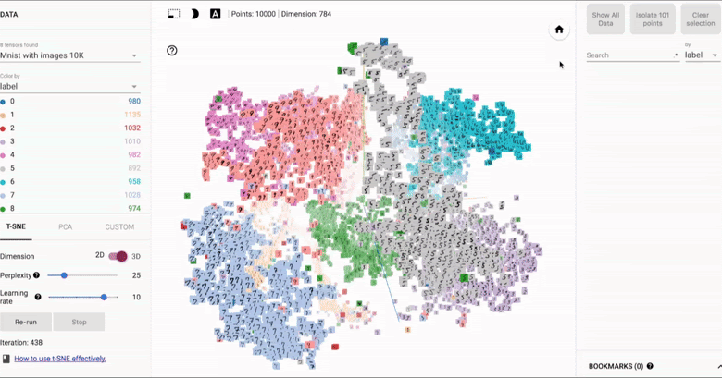
REPRESENTATION
Facial Encodings & Embeddings
What are Facial Embeddings?
Embedding Space Visualization
Facial embeddings are numerical representations of faces in a high-dimensional vector space. FaceNet generates 128-dimensional vectors for each face.
Key Properties:
• Compact: 128 numbers represent a face
• Comparable: Use distance metrics
• Robust: Invariant to pose, lighting
MNIST digits clustered by class in 2D embedding space
Embedding Space Properties
Similar Faces = Close Embeddings
Distance Metrics
Same person → Small Euclidean distance
Euclidean Distance (L2)
Different Faces = Far Embeddings
d(x,y) = √Σ(xᵢ - yᵢ)²
Different people → Large Euclidean distance
Most commonly used
Clustering by Identity
Cosine Similarity
Same person forms a cluster in embedding space
sim = (x·y) / (||x|| ||y||)
Measures angle between vectors

Slide 9
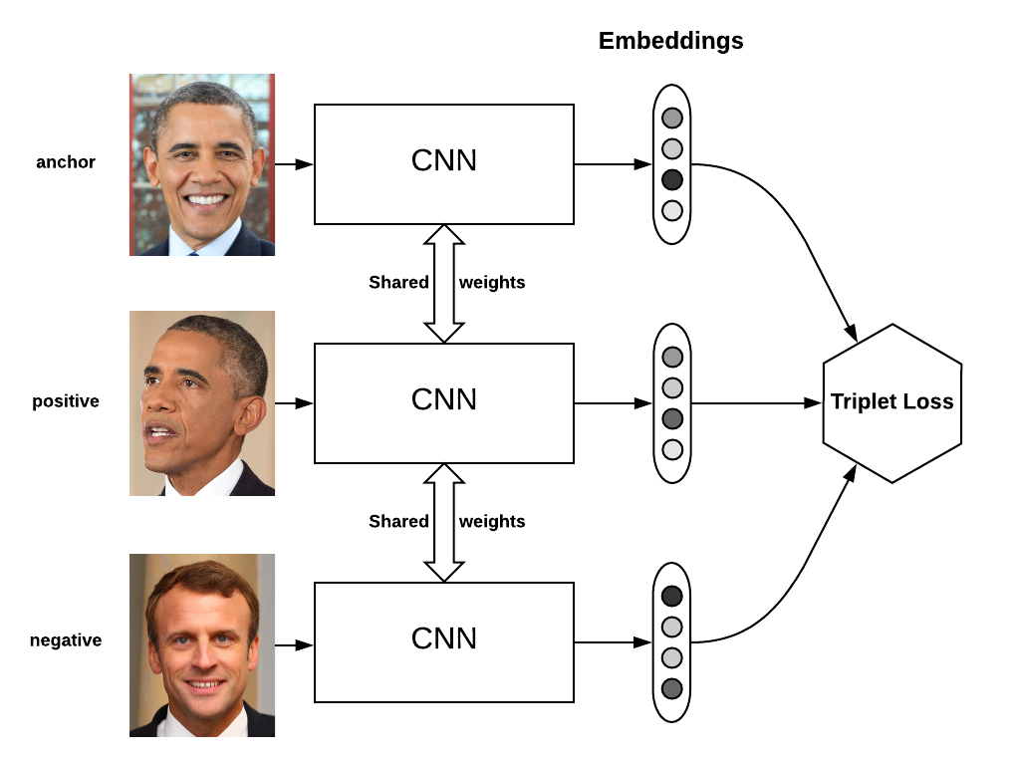
CHAPTER 03
Triplet
Loss
Training Siamese Networks Effectively

Slide 10
L(A,P,N) = max(||f(A) - f(P)||² - ||f(A) - f(N)||² + α, 0)
TRAINING STRATEGY
Understanding Triplet Loss
The Triplet Concept
Triplet Loss Architecture
Triplet loss uses three images for training:
A
Anchor
Reference image of a person
P
Positive
Another image of same person
N
Negative
Image of a different person
Training Goals
Three inputs processed through shared CNN
Goal 1: Minimize d(A,P)
Push anchor and positive embeddings closer together
Triplet Loss Formula
Goal 2: Maximize d(A,N)
Loss Function:
Push anchor and negative embeddings farther apart
L(A,P,N) = max(||f(A) - f(P)||² - ||f(A) - f(N)||² + α, 0)
Result: Same person embeddings cluster together, different people are separated
||f(A) - f(P)||²
= Squared distance between anchor and positive
||f(A) - f(N)||²
= Squared distance between anchor and negative
α
= Margin (hyperparameter)

Slide 11
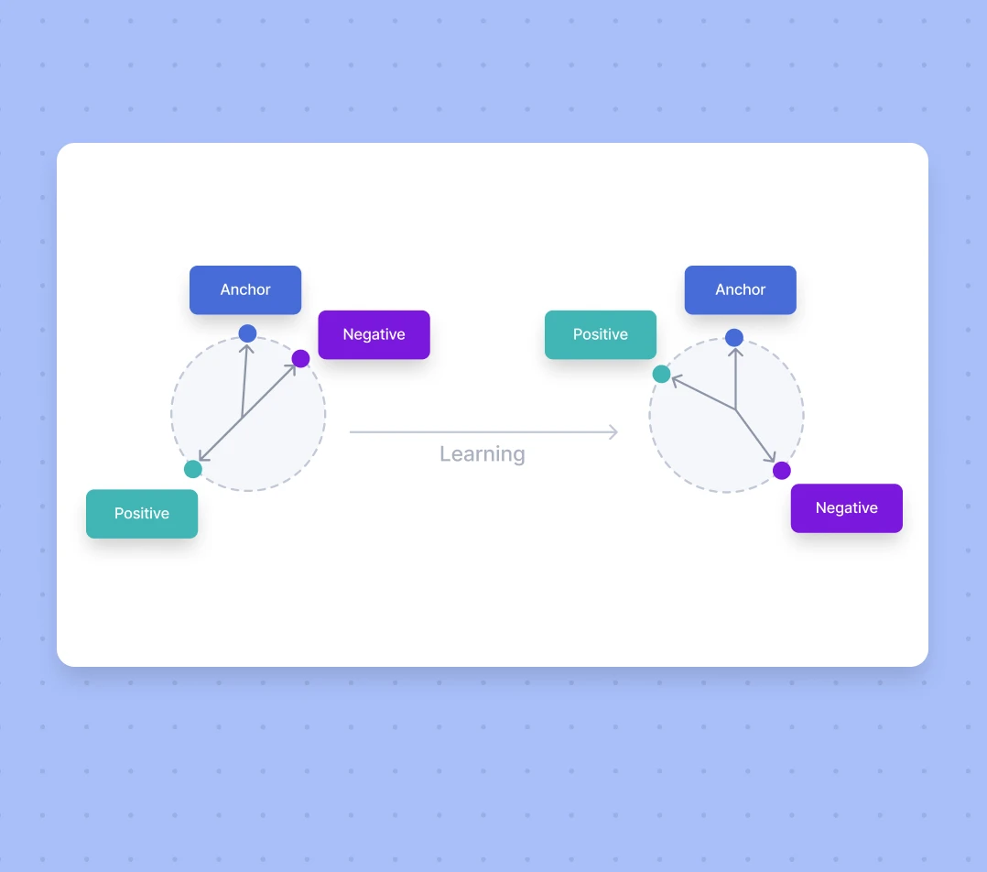
OPTIMIZATION
Triplet Selection Strategy
Training Visualization
The Problem with Random Selection
Randomly selecting triplets is inefficient because:
Easy Triplets
d(A,P) ≪ d(A,N) - Network learns nothing new
Wasted Computation
Most random triplets produce zero loss
Slow Convergence
Training takes much longer
Before vs After training - positive moves closer, negative moves farther
Hard Negative Mining
Training Process
Select triplets where d(A,P) ≈ d(A,N):
Step 1: Select Triplets
Choose A, P, N intelligently (hard negatives)
Hard Negatives
Negative looks similar to anchor - forces learning
Step 2: Forward Pass
Compute embeddings f(A), f(P), f(N)
Better Training
Step 3: Calculate Loss
Network learns subtle distinctions
Apply triplet loss formula
Faster Convergence
Step 4: Backpropagation
More informative gradients
Update shared CNN weights

Slide 12
COMPLETE SYSTEM
FaceNet: Putting It All Together
Google's FaceNet (2015)
Face Recognition Pipeline
FaceNet is a unified embedding system that achieved state-of-the-art results on LFW benchmark using:
Architecture
Loss Function
Inception/ResNet CNN
Triplet Loss
Output
Training
128-d embedding
End-to-end learning
Complete Pipeline
1
Face Detection
Locate and crop face from image (MTCNN)
2
Alignment
Normalize pose, scale, and position
3
Encoding
Generate 128-dimensional embedding
4
Comparison
Calculate Euclidean distance
5
Decision
Compare to threshold τ
5-step verification process

Slide 13
CHAPTER 04
Exam &
Interview Prep
Test Your Understanding

Slide 14
PRACTICE QUESTIONS
Conceptual Questions
Q1
What is the difference between face recognition and face verification?
Q2
Why can't we use standard classification for face recognition with many people?
Answer:
Answer:
Verification (1:1): Confirms if a person is who they claim to be by comparing against one stored template. Returns YES/NO.
Recognition (1:N): Identifies who a person is by searching across an entire database. Returns identity.
• Softmax becomes unstable with many classes
• Need to retrain entire network for new people
• Insufficient data (one image per person)
• Output layer size keeps changing
Q3
What is one-shot learning and why is it important?
Q4
How does a Siamese network work?
Answer:
Answer:
One-shot learning is recognizing a person from just one example. It's crucial because real-world scenarios often have only one image per person (ID photos, employee databases). Traditional deep learning needs hundreds of examples per class.
A Siamese network has two identical CNNs with shared weights. It takes two images, generates embeddings for both, calculates the distance between them, and decides if they're the same person based on a threshold.

Slide 15
TECHNICAL QUESTIONS
Technical Questions & Formulas
Q1
Write the triplet loss formula and explain each term.
Q3
Why do we use hard negative mining?
Formula:
Answer:
L = max(||f(A)-f(P)||² - ||f(A)-f(N)||² + α, 0)
Random triplets often produce zero loss (easy negatives). Hard negative mining selects triplets where d(A,P) ≈ d(A,N), forcing the network to learn subtle distinctions and improving training efficiency.
• f(A): Embedding of anchor image
• f(P): Embedding of positive (same person)
• f(N): Embedding of negative (different person)
• α: Margin hyperparameter
Q4
How do we decide if two faces match?
Q2
What is the role of margin α in triplet loss?
Answer:
Calculate Euclidean distance d between embeddings:
Answer:
If d < τ → Same person ✓
The margin α ensures that the distance between anchor and positive is significantly smaller than the distance between anchor and negative. It prevents the model from learning trivial solutions and forces a clear separation between classes.
If d ≥ τ → Different person ✗

Slide 16
QUICK TEST
Multiple Choice Questions
1
Face verification is a ___ matching problem.
2
Triplet loss uses how many images?
(a) 1:N
(a) 2
(b) 1:1 ✓
(b) 3
(c) N:N
(c) 3 ✓
(d) N:1
(d) 5
Anchor, Positive, Negative
3
What distance metric is commonly used?
4
Face recognition requires user consent?
(a) Manhattan
(a) Always
(b) Euclidean ✓
(b) Never ✓
(c) Cosine
(c) Sometimes
(d) All of the above
(d) Optional
Can work passively in surveillance
5
What is the output dimension of FaceNet embeddings?
6
Siamese networks have ___ weights.
(a) 64
(a) Different
(b) 128 ✓
(b) Shared ✓
(c) 256
(c) Random
(d) 512
(d) Fixed

Slide 17
IMPLEMENTATION
Coding & Implementation Questions
Q1
Pseudocode for triplet loss calculation
Q3
Evaluation metrics for face verification
def triplet_loss(anchor, positive, negative, alpha): # Calculate squared distances d_ap = sum((a - p) ** 2) d_an = sum((a - n) ** 2) # Compute loss loss = max(d_ap - d_an + alpha, 0) return loss
FAR (False Acceptance Rate)
% of different people incorrectly accepted
FRR (False Rejection Rate)
% of same people incorrectly rejected
Accuracy
Overall correct predictions
Q2
Preprocessing steps for face images
ROC-AUC
1. Detection: Locate face using MTCNN/Haar cascade
Area under ROC curve
2. Alignment: Normalize eye positions
3. Resizing: Standard size (e.g., 160x160)
4. Normalization: Scale pixel values [0,1] or [-1,1]
Key Implementation Tips
5. Augmentation: (Optional) Random flips, rotations
Use Pretrained Models
Start with FaceNet, OpenFace, or DeepFace weights
Tune Threshold τ
Find optimal balance between FAR and FRR
Handle Edge Cases
Occlusions, lighting variations, pose changes

Slide 18
Key Takeaways
What You Should Remember
01
Face Verification vs Recognition
02
One-Shot Learning
Verification is 1:1 matching (confirms identity), Recognition is 1:N search (identifies from database)
Recognizing from single example per class. Essential for real-world scenarios with limited training data
03
Siamese Networks
04
Triplet Loss
Two identical CNNs with shared weights that learn similarity functions instead of classification
Uses Anchor, Positive, Negative to push same-person embeddings together and different-person embeddings apart
05
Facial Encodings
Faces converted to 128-dimensional vectors (FaceNet). Similar faces have small Euclidean distance, different faces have large distance
Good luck with your exams and interviews!

